Slide 1
Qos AND TRAFFIC ENGINEERING

Slide 2
Overview of Qos
Qos stands for Quality of Service.
Qos is a set of tools and techniques used to manage and improve the performance of a network. It is used to prioritize traffic, allocate resources, and ensure that data packets are delivered in a timely manner.
Qos can be used to improve the performance of applications such as VoIP, video streaming, and online gaming.
It refers to a technology used to manage data traffic to reduce data packet loss, latency(delay) and jitter (signal pulse displacement).

Slide 3
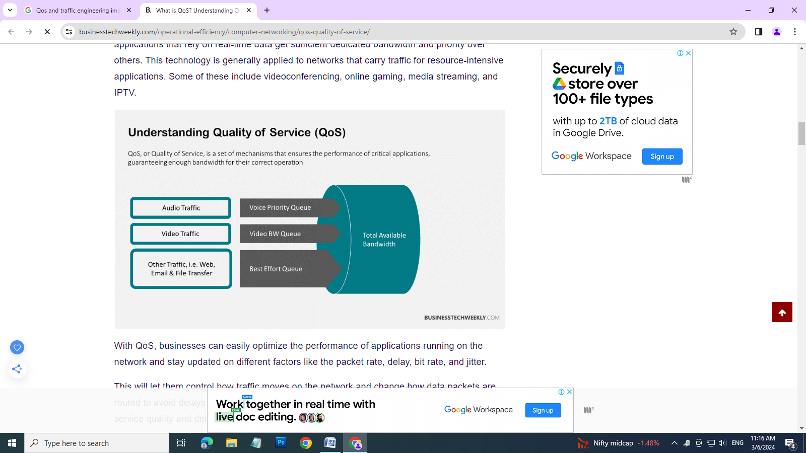

Slide 4
Important Quality of service(QoS)
Interactive applications carrying audio and video content need to be delivered at high speed, without packet loss.
Critical applications must be guaranteed high bandwidth for real time traffic to achieve no data packet loss, without latency and jitter.
To ensure real time feeling during live streaming and video conference.
Since large of people are using network communication, the network performance must be high so that the network performance must be high so that the users can satisfy with the service.
Since internet of things (IOT) gives real time status updates, any delay will cause great negative effect.

Slide 5
Techniques implemented in QoS
Prioritization: Routers and switched starts dropped data packets when they become over crowded. As a result, streaming application suffers. Prioritization helps to regularize data traffic depending on its and destination with the help of different priorities.
Traffic marking: once the high priority application is identified mark the traffic using processes like DSCP or CoS.
Resource reservation : This helps the organization to define data limits and guarantee band with by dividing the network resources depending on different data traffic and logic of data.
Queuing: Queuing is a process of creating policies that give importance to certain type of data over others. This is done by assigning high priority to important data and removed it to a dedicated queue that pushes data at a faster rate.

Slide 6
Advantages
High performance.
Latency is reduced.
Better resource management.
Point to point traffic management without any data packet loss.

Slide 7
Overview of traffic engineering techniques and protocols
Traffic engineering is the process of reconfiguring the network according to changing traffic loads. This is carried out to achieve some operational goals. A network operator may reconfigure the network for any one of the following reason.
To maintain traffic rations with the other node.
To relieve congestion on certain links.
To balance load more evenly.

Slide 8
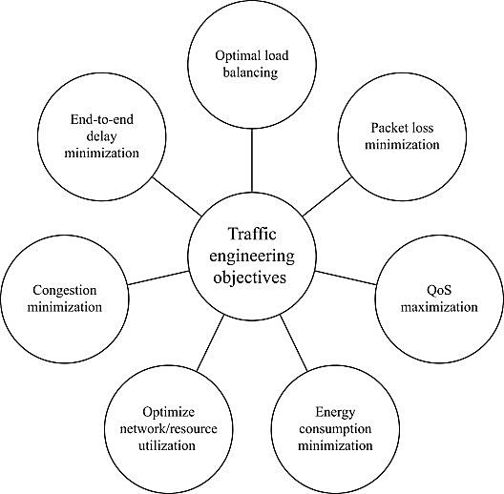

Slide 9
Basically traffic engineering involves inspecting the network to ensure sufficient capacity exists to handle the demand from the clients to meet the QoS objectives. Figure shows the various objectives for using traffic engineering.
Traffic engineering methods to regulate network traffic.

Slide 10
First in, first out queuing (FIFO)
Packets are placed into a hierarchy of queues based on Priority.
When there are no more packets in high priority. When there are no more packets in the high priority queue the next lower priority queue is serviced.
Priority quenching.
Fair Quenching.
In fair quenching each packet is assigned a type and placed into the queue for that type. All queues are serviced in a round robin fashion.
Weighted Fair quenching.
Weighted fair quenching is same as fair quenching. But priorities are given to queues.

Slide 11
Hierarchical weighted fair quenching.
Hierarchical weighted fair quenching is similar to weighted fair quenching. But it monitors traffic and evaluates current contains to adjust queues.

Slide 12
OAM
OAM stands for operations, Administration and management. OAM is a set of functions that provides system or network fault indication, performance monitoring, security management, diagnostic functions, configuration and user provisioning.
The purpose of these management tools or capabilities is to enable the monitoring and quick restoration of a network in case of failure.
This provides the following functions to restore the network quickly in case of failure.
Network fault condition
Performance monitoring
Diagnostic functions
Network Configuration.
User Provisioning

Slide 13
Ethernet OAM is very important because network base operations are increased and most of the day to day operations are carried out using online mode.
Therefore the above functions are used to monitor and restore the network quickly in case of failure. IEEE has given the following standards to implement OAM.

Slide 14
IEEE 802.1 ag
This focuses on the end to end connectivity and continuity of nodes in an either net network. Therefore this is referred as connectivity fault management or CHM.
This has the following three main functions. They are:
Loopback message and response (LBM/LBR)
LBM and LBR are used to determine the integrity of the data path. Once a network fault has been established, the service provider can verify the loss by initiating loopback test.
Continuity Check Messages (CCM)
This is an OAM protocol data unit (OAMPDU) that provides service monitoring from one end point to another.
Link trace message and response (ITM /LTR)
LTM and LTR are used by the service provide maintenance domain to verify the complete link with in the network. Once a network fault has been confirmed by the service provider, this feature can be used to isolate the specific location.

Slide 15
b) IEEE 802.3 ah
This focuses on the verification of end to end connectivity across multiple domains and hops.
This uses the following techniques.
Loopback: An OAM entity can put its remote peer into loopback mode. This helps the administrator to ensure the link quality during installation or troubleshooting.
Discovery: This is the first phase and is used to identify the devices in the network with their OAM capabilities. If the discovery fails, all other OAM activity is terminated until the discovery is reestablished.
Remote failure indication: This technique is used to convey the degradation of an Ethernet link.
Ethernet link force: This technique is used for fault isolation.

Slide 16
Fault detection and isolation
Depending on the OAM standard used, several types of test can be performed to detect, verify, locate and notify the various defect conditions. They are,
CSF test
During this test, the tester generates and detects a client signal fail (CSF) to validate the reception and behavior of the maintenance domain.
Continuity check
This is used to confirm the presence of a test equipment on a network and to verify the presence of other test equipment's. During this test transmitted frames are either received by all test equipment using an uncast destination address or by all test equipment's using a multicast destination address.
Link trace test
This test verifies that the complete link trace reaches all the equipment's in the maintenance domain. The tester will send LTM message and receives LTR messages.

Slide 17
Test function
In this, the tester generates frames with a specific test pattern and sequence number in order to verify the integrity of the signal received by the maintenance domain.
Loopback test
During this test, the tester transmits LBM payload with a specific sequence number. The equipment's responds to the LBM with an LBR payload. The test validates each received LBR and reports any invalid LBR.
RDI test
In this the tester generates a Remote Defect Indicator (RDI) to simulate a defect and validate the reaction and behaviors of the maintenance domain.
Lock signal test
This test is used to generate and detect locked signals. When a lock signal is received, the tester sounds an alarm.

